Slide 1

Intro To Software Testing

Slide 2

Agenda
What is Software?
What is testing and software testing
Why Testing is Important
What is Bug and How to find Bugs
Type of Errors in SW
Testing Specification
Types of SW Testing in SW Engineering
Testing Levels
Testing Methodology
SDLC and STLC
V model

Slide 3
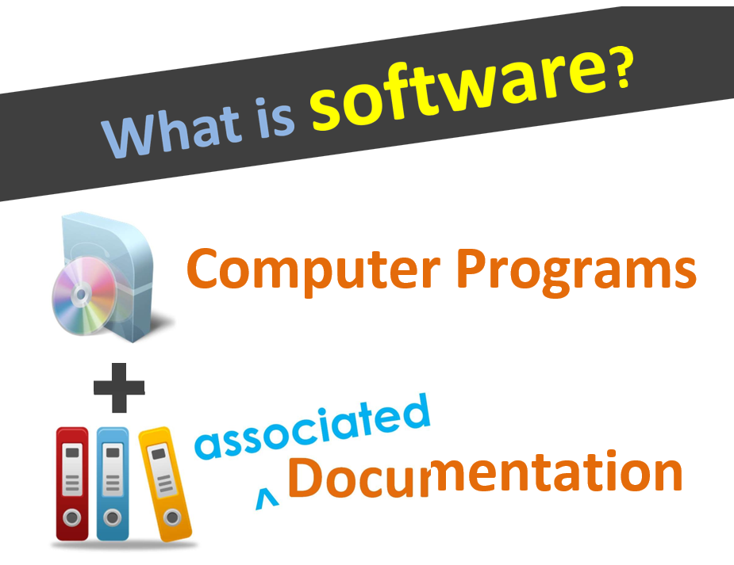

Slide 4

Documentation Types
User Documentation
Technical Documentation
Marketing Documentation

Slide 5
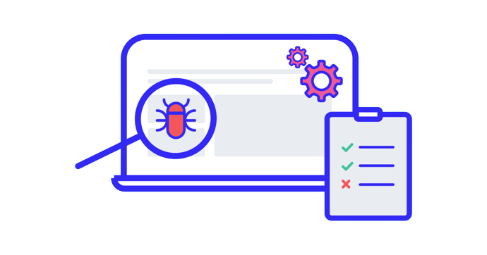
What is Software Testing
Software Testing is a method to check whether the actual software product matches expected requirements and to ensure that software product is Defect free

Slide 6
Why Testing is Important?
To find and correct defects.
To Check whether the user’s needs are satisfied.
To avoid user detecting problems.
Also, to provide quality products.

Slide 7
Objectives
Ensure requirement matching with customer needed.
Define defects.
Prevent defects.
Ensure best quality.
Generate High quality test cases.

Slide 8
Why does SW have Bugs?
Miscommunication or No Communication.
That we are not clear about what an application should do or shouldn’t de.
Time Pressure.
Programming Mistakes.
Changing Requirements.

Slide 9
SW Testing Misunderstanding
Testing is debugging.
If programmers were more carful, testing would be unnecessary.
Testing activities start only after the coding is complete.
Testing never ends.
Testing is not a creative task.
Manual testing only.

Slide 10

What is Bug and How to find Bugs
A Bug is the deviation of the actual result from the expected result
Notes:
The following quotation is taken from a Wikipedia.org article :
"The first "documented' computer bug was a moth found trapped between points at Relay #70, Panel F, of the Mark II Aiken Relay Calculator while it was being tested at Harvard University, 9 September 1947. Grace Hopper affixed the moth to the computer log, with the entry : 'First actual case of bug being found.""

Slide 11
Type of Errors in SW
A person makes an Error That creates a fault in software That can cause a failure in operation
Error:
An error is a human action that produces the incorrect result that results in a fault.
Bug:
The presence of error at the time of execution of the software.
Fault:
State of software caused by an error.
Failure:
Deviation of the software from its expected result. It is an event.

Slide 12
Type of Errors in SW
For any integer n, square (n) = n*n
Int square(int x)
{
return x*2;
}
Square(2) = 4
Correct result
Fault/Bug
Square(3) = 6
Failure

Slide 13
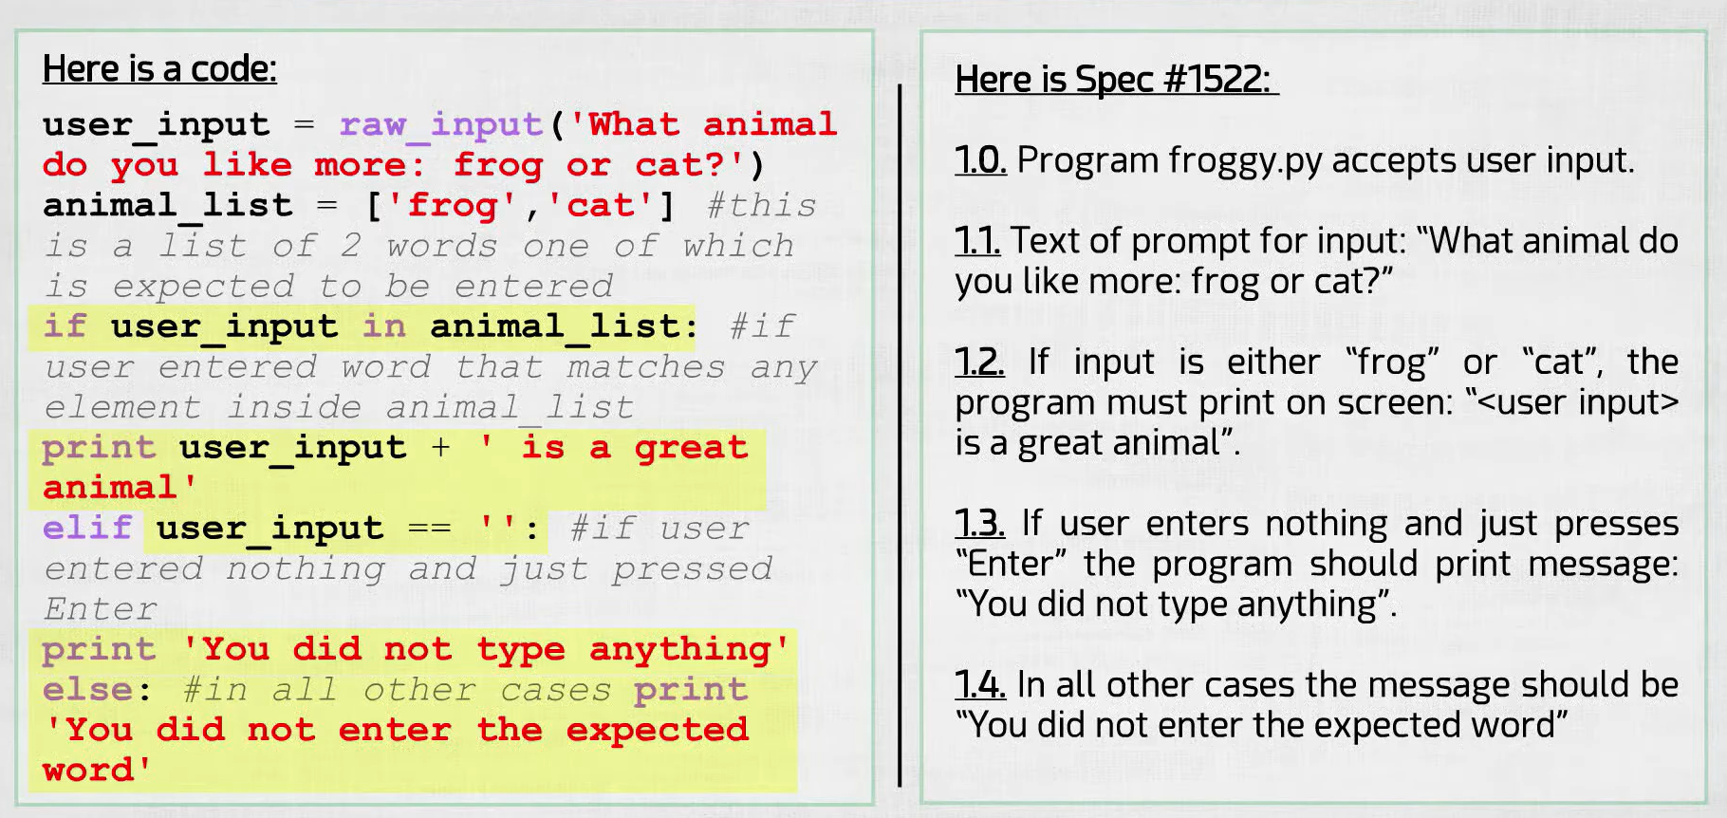
Testing Specification

Slide 14
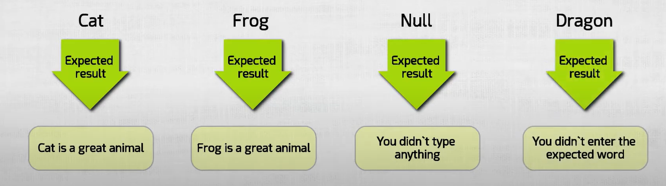
Test Cases

Slide 15
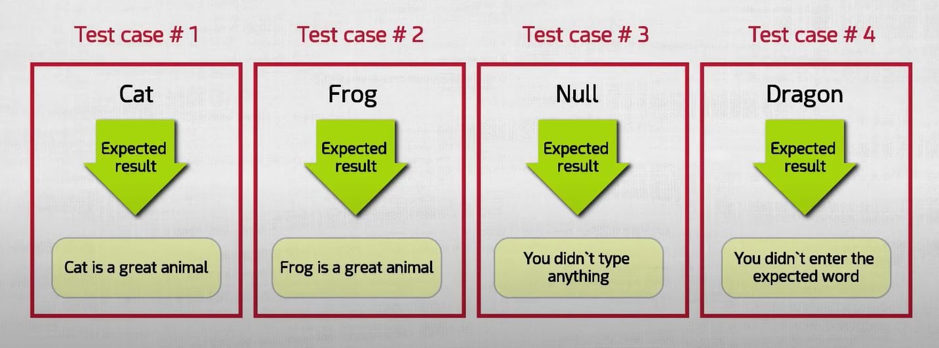
Test Cases No.

Slide 16
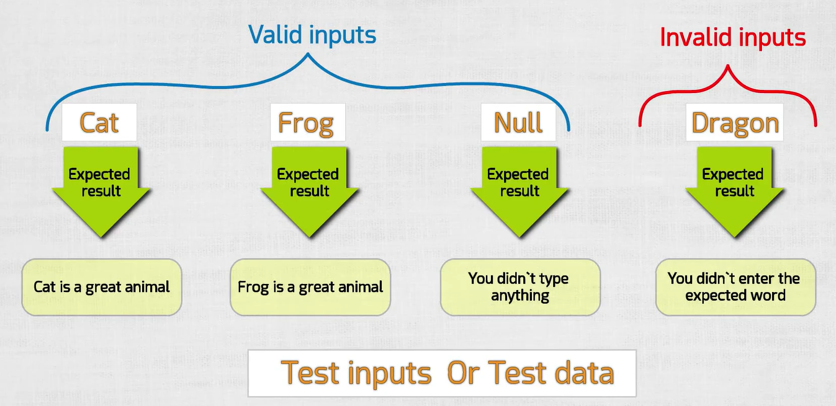

Slide 17
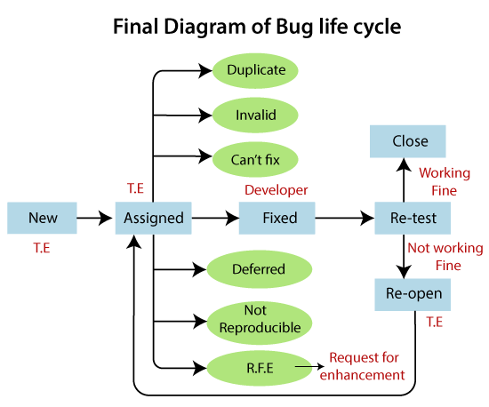
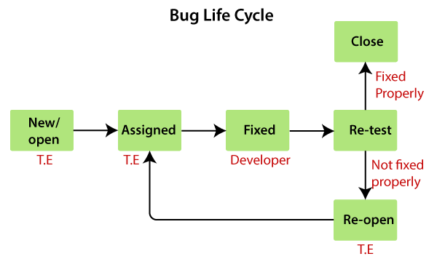
Bug Life Cycle

Slide 18
Software Free Error
Tester must make sure that 100% of the software work fine and error free
Whether we like it or not, there is always a probability that bugs will be missed by testers.
Testing cannot cover 100% of the possibilities of how software can operate.

Slide 19
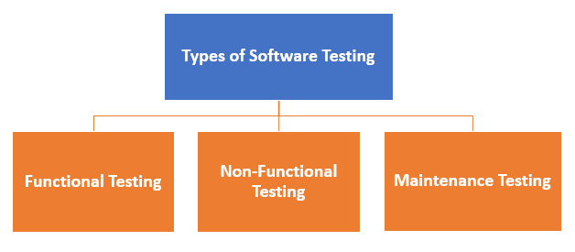
Types of SW Testing

Slide 20
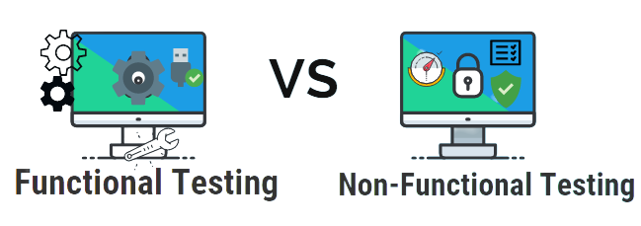
Types of SW Testing in SW Engineering
Functional Testing
Unit Testing
Integration Testing
UAT (user accepted testing)
Non-Functional Testing
Performance
Usability
Scalability
Maintenance
Regression
Maintenance
Notes:
Types of Software Testing: Different Testing Types with Details (softwaretestinghelp.com)

Slide 21
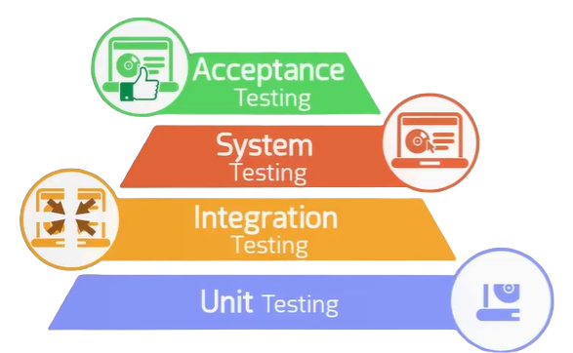
Level of Testing

Slide 22
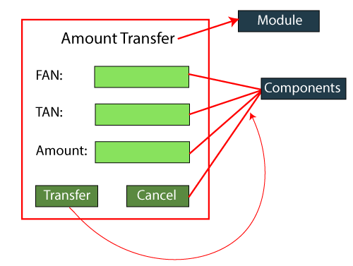
Unit testing example
Notes:
Unit Testing Tools
NUnit
JUnit
PHPunit
Parasoft Jtest
EMMA

Slide 23
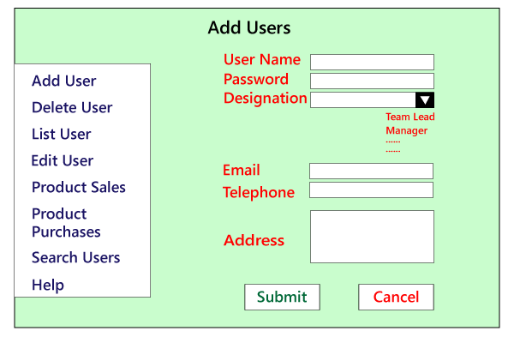
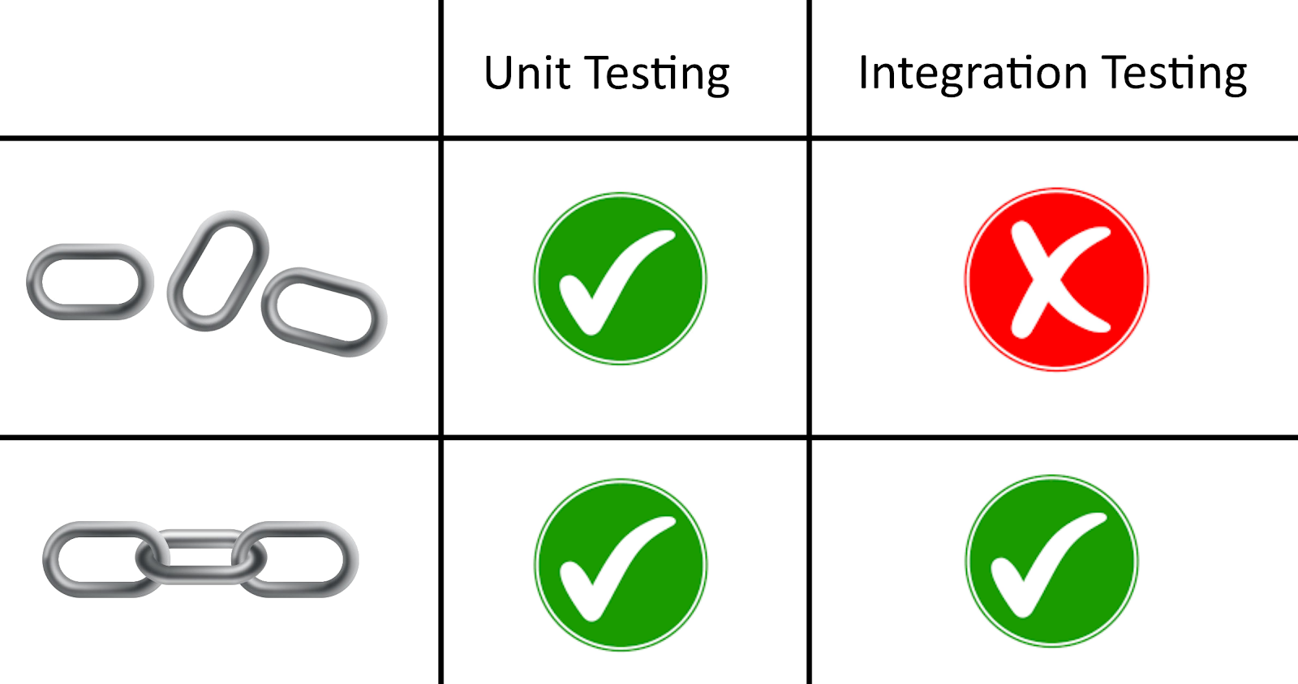
Integration testing example

Slide 24
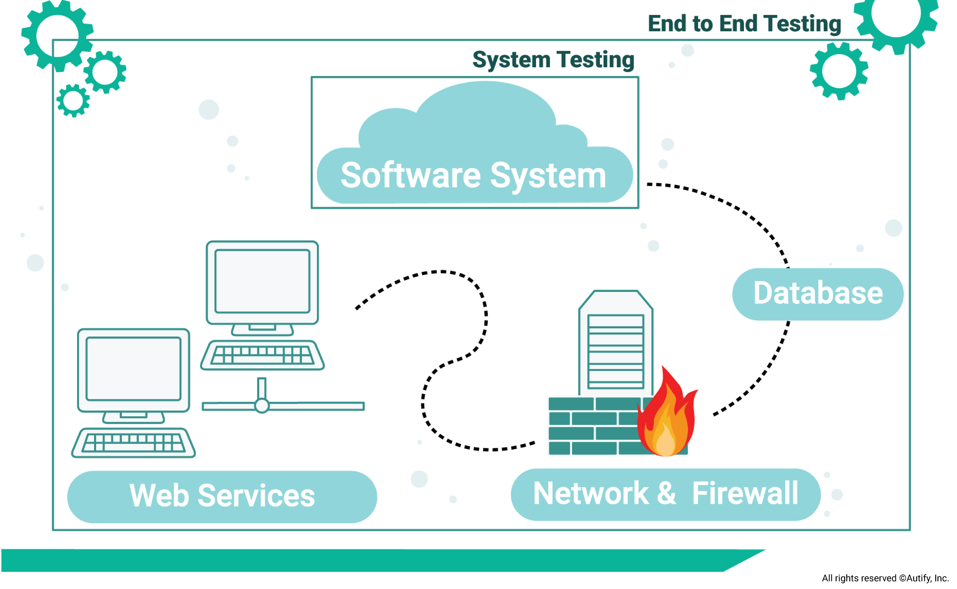
System Testing

Slide 25
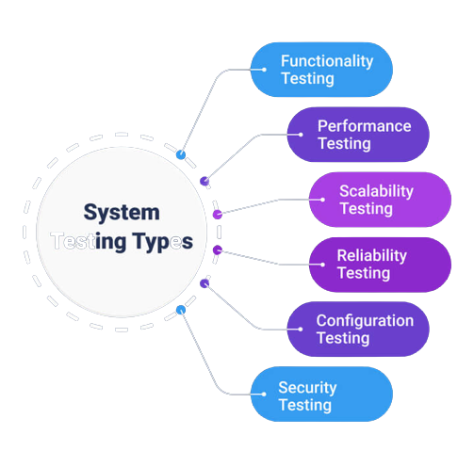
System Testing types

Slide 26
Testing Methodology
Black box testing
No knowledge of internal program design required.
Tests are based on requirements and functionality. or code
White box testing
Knowledge of the internal program design and code required.
Tests are based on coverage of code statements, branches, paths, conditions.

Slide 27
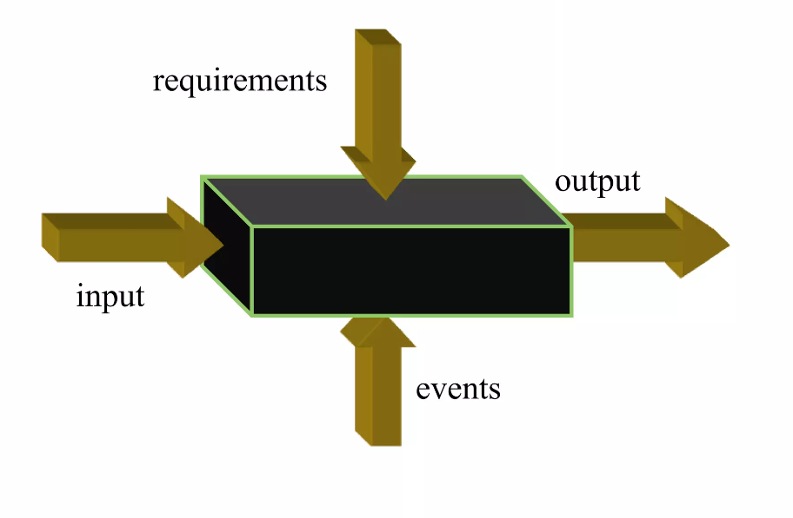
Black box testing
Applied for functional and non-functional testing, without reference to the internal structure of the system

Slide 28
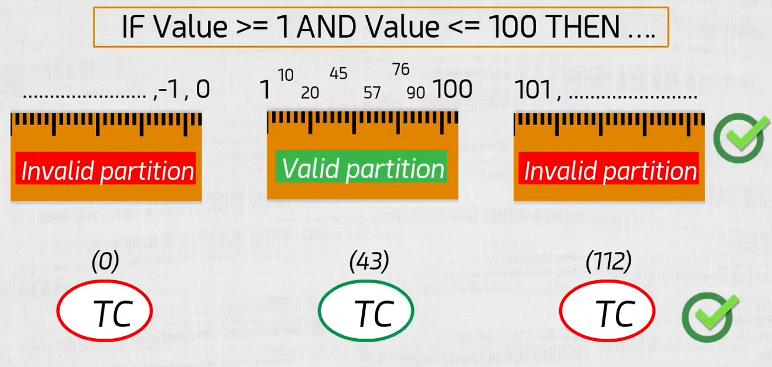
Black box testing techniques
Equivalence Partitioning (EP)
EX: range of data -> if VALUE is between 1 and 100 then print ‘Pass’

Slide 29
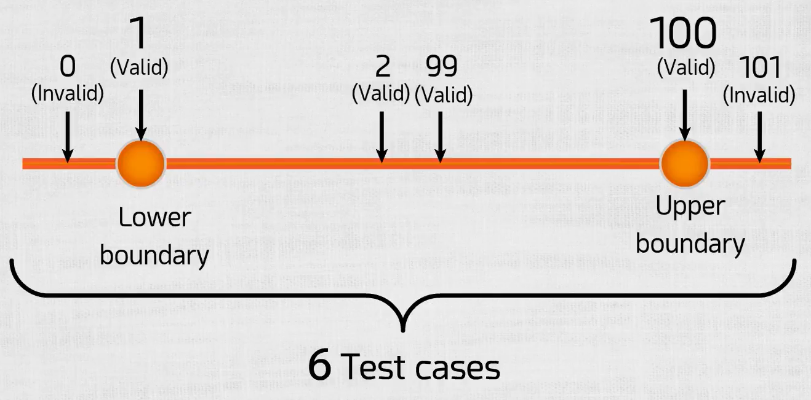
Black box testing techniques
2. Boundary value analysis(BVA)
EX: range of data -> if VALUE is between 1 and 100(inclusive). then print ‘Pass’
Find the boundary.
Lower boundary.
Upper boundary.
Test one value above and below it.
Applicable for numeric fields and date.

Slide 30
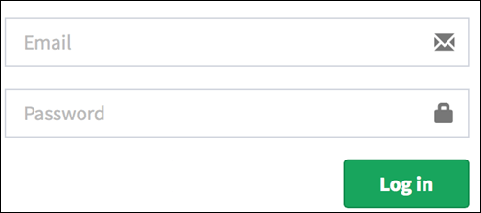
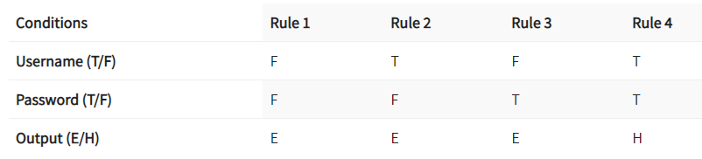
Black box testing techniques
Decision Table Testing
Used to test system behavior for different input combinations.
Decision Table is a tabular representation of inputs versus rules/cases/test conditions.
Ex:
Notes:
Legend:
T – Correct username/password
F – Wrong username/password
E – Error message is displayed
H – Home screen is displayed
Interpretation:
Case 1 – Username and password both were wrong. The user is shown an error message.
Case 2 – Username was correct, but the password was wrong. The user is shown an error message.
Case 3 – Username was wrong, but the password was correct. The user is shown an error message.
Case 4 – Username and password both were correct, and the user navigated to the homepage

Slide 31
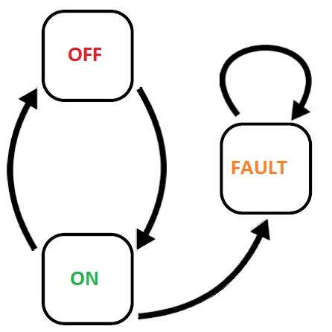
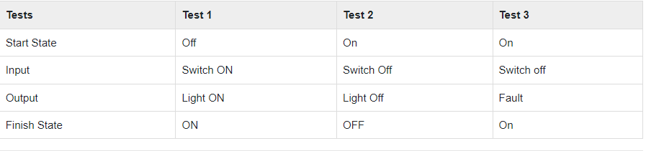
Black box testing techniques
State Transition Testing
Used in which outputs are triggered by changes to the input conditions.
Designed to execute valid and invalid state transitions.
Ex:
Notes:
Search on State diagram
Best Black Box Testing Tool To Try In 2022 - hikeqa

Slide 32
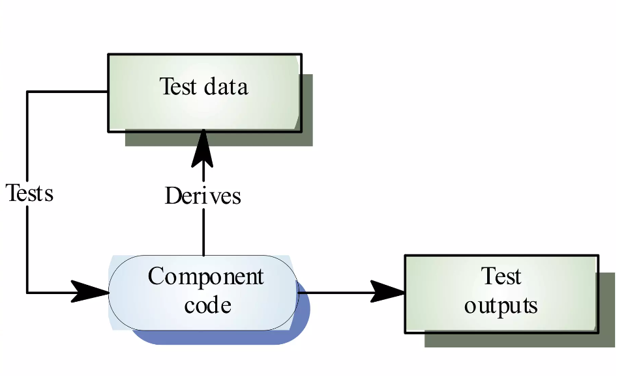
White box testing
Testing based on analysis of the internal structure of the component or system

Slide 33
White box testing techniques
The goal of White Box testing in software engineering is to verify all the decision branches, loops, and statements in the code.
Statement Coverage:
we would only need one test case to check all the lines of the code.
If I consider TestCase_01 to be (A=40 and B=70), then all the lines of code will be executed.
INPUT A & B
C = A + B
IF C>100
PRINT “ITS DONE”

Slide 34
White box testing techniques
Branch Coverage:
which will evaluate the “FALSE” conditions.
Branch coverage to ensure maximum coverage.
TestCase_01: A=33, B=45
TestCase_02: A=25, B=30
INPUT A & B
C = A + B
IF C>100
PRINT “ITS DONE”
Else
print “Its Pending”
Notes:
Branch Coverage ensures more coverage than Statement coverage.
Branch coverage is more powerful than Statement coverage.
100% Branch coverage itself means 100% statement coverage.
But 100 % statement coverage does not guarantee 100% branch coverage.

Slide 35
White box testing techniques
Path Coverage:
used to test the complex code snippets.
which basically involve loop statements or combination of loops and decision statements.
To ensure maximum coverage, we would require 4 test cases.
INPUT A & B
C = A + B
IF C>100
PRINT “ITS DONE”
END IF
IF A>50
PRINT “ITS PENDING”
END IF

Slide 36
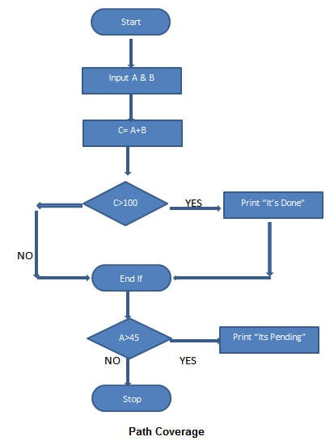
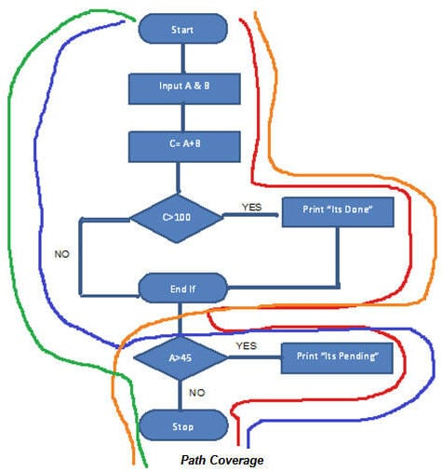
TestCase_01: A=50, B=60
TestCase_02: A=55, B=40
TestCase_03: A=40, B=65
TestCase_04: A=30, B=30
Notes:
Red Line – TestCase_01 = (A=50, B=60)
Blue Line = TestCase_02 = (A=55, B=40)
Orange Line = TestCase_03 = (A=40, B=65)
Green Line = TestCase_04 = (A=30, B=30)

Slide 37
Test cases objectives
Test to pass(Happy scenario)
Assures that the software minimally works
Applies simple and straightforward test cases
Test to fail(Bad scenario)
Choose test cases to appear the weaknesses in software
Designing test cases with the sole purpose of breaking the software

Slide 38
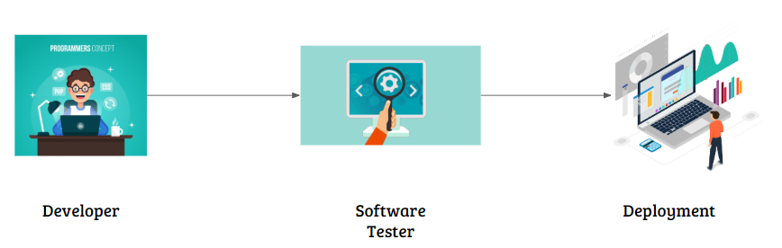
Software Deployment Cycle

Slide 39
SDLC and STLC
SDLC: SDLC is Software Development Life Cycle. It is the sequence of activities carried out by Developers to design and develop high-quality software.
STLC: STLC is Software Testing Life Cycle. It consists of a series of activities carried out by Testers methodologically to test your software product.

Slide 40
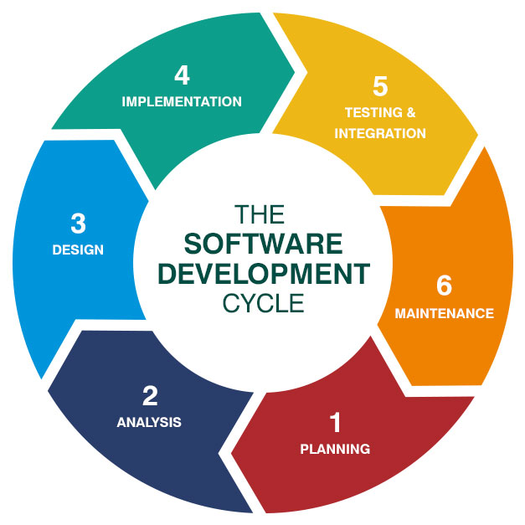
SDLC

Slide 41
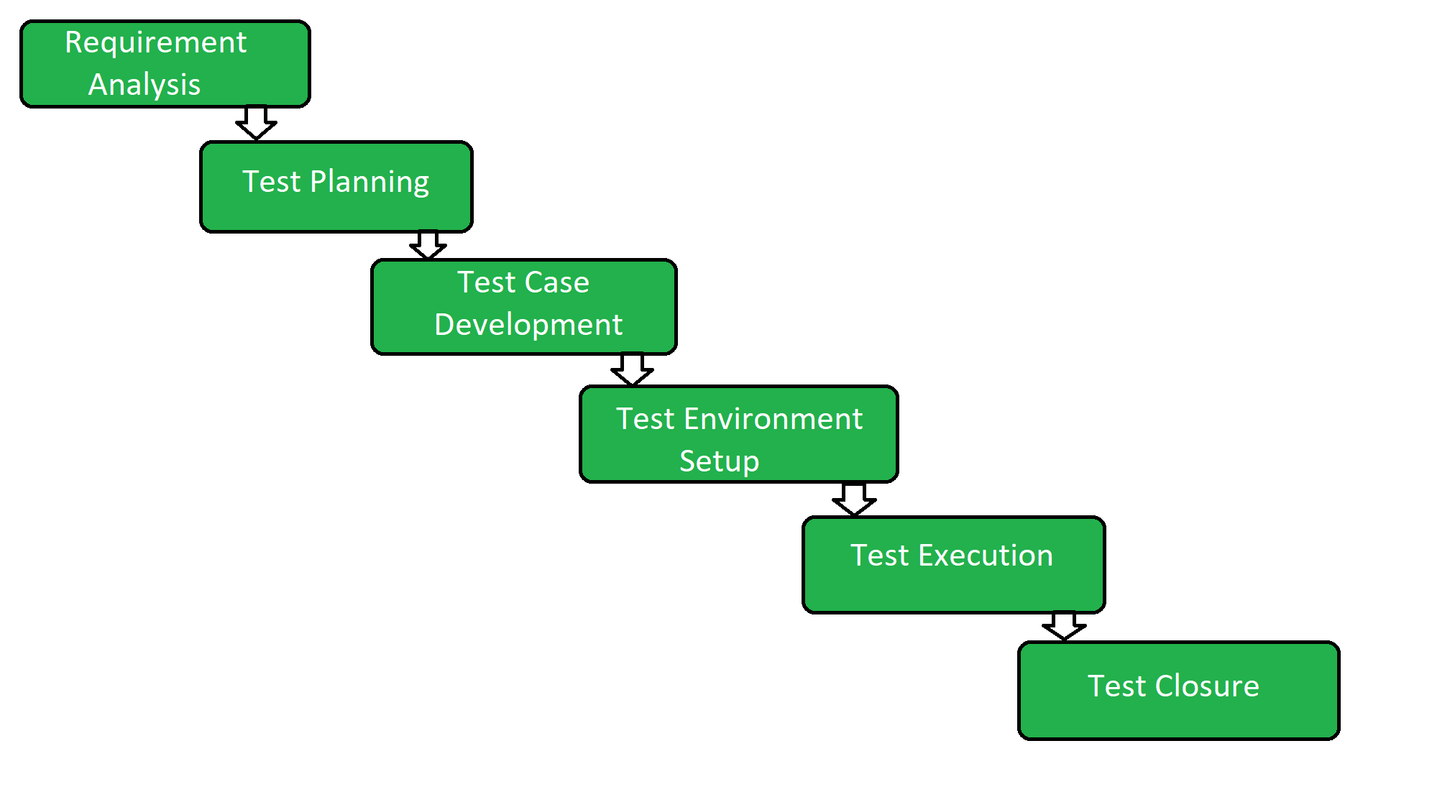
STLC Life Cycle

Slide 42
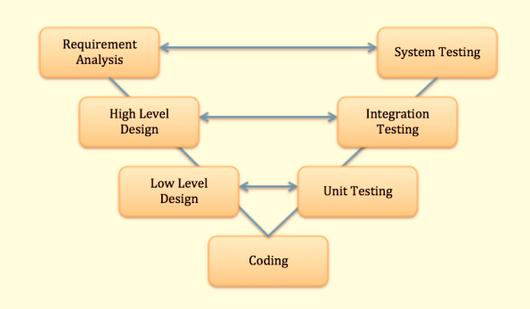
V Model

Slide 43
Thanks

